Slide 1


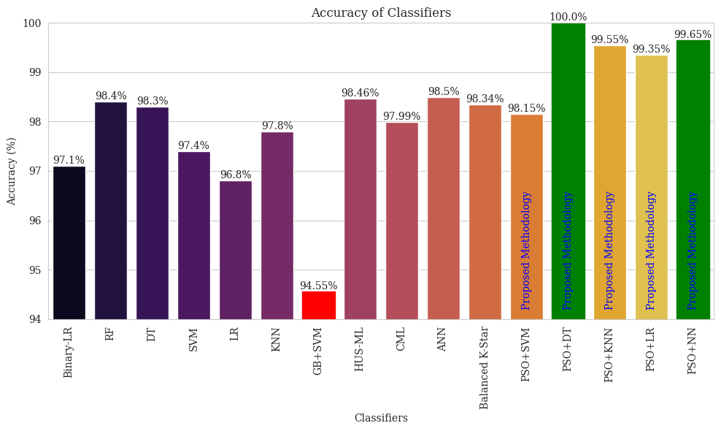


K. J. SOMAIYA INSTITUTE OF TECHNOLOGY
Department of Artificial Intelligence and Data Science
Project Title
Student Name 1, Student Name 2, Student Name 3
Guide: Faculty Name
Abstract
Particle Swarm Optimization (PSO) is an optimization solution, utilizing a swarm of particles to dynamically explore solution
Background
The Industrial Internet of Things
Figure 1: Effect unplanned downtime
Objectives
To implement and evaluate PSO-driven classifiers,
Methodology
Particle Swarm Optimization (PSO) is
Figure 2: Proposed Methodology
Result and Discussion
Particle Swarm Optimization (PSO)
Figure 3: Comparison of PSO driven Classifiers with previous reported work
Conclusion
PSO driven classifiers SVM, DT, KNN, LR and NN showed remarkable performance, with accuracy of 98.15%, 100.00%, 99.55%, 99.35%, and 99.65%.
Achievements
(Write details of Hackathon/ Prize/Rank/Publication details/ If no achievement delete this Tab)
Acknowledgement
This research work is supported by K. J. Somaiya Institute of Technology.
References
[1] H. Kamel, “Artificial intelligence for predictive maintenance,” J. Phys. Conf. Ser., vol. 2299, no. 1, p. 012001, Jul. 2022.
[2] B. Ghasemkhani, O. Aktas, and D. Birant, “Balanced K-Star: An Explainable Machine Learning Method for Internet-of-Things-Enabled Predictive Maintenance in Manufacturing,” Machines, vol. 11, no. 3, Mar. 2023.

